Slide 1
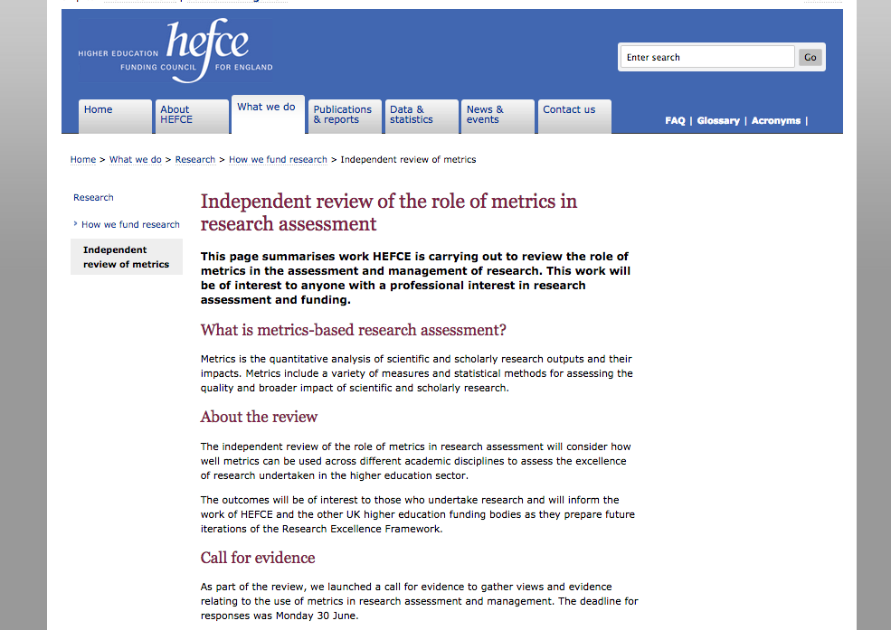

Slide 2
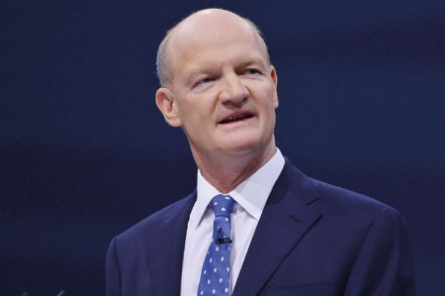
“I can announce today that I have asked HEFCE to undertake a review of the role of metrics in research assessment and management. The review will consider the robustness of metrics across different disciplines and assess their potential contribution to the development of research excellence and impact…It will report in spring 2015”
David Willetts, Minister for Universities & Science, Speech to UUK, 3 April 2014

Slide 3
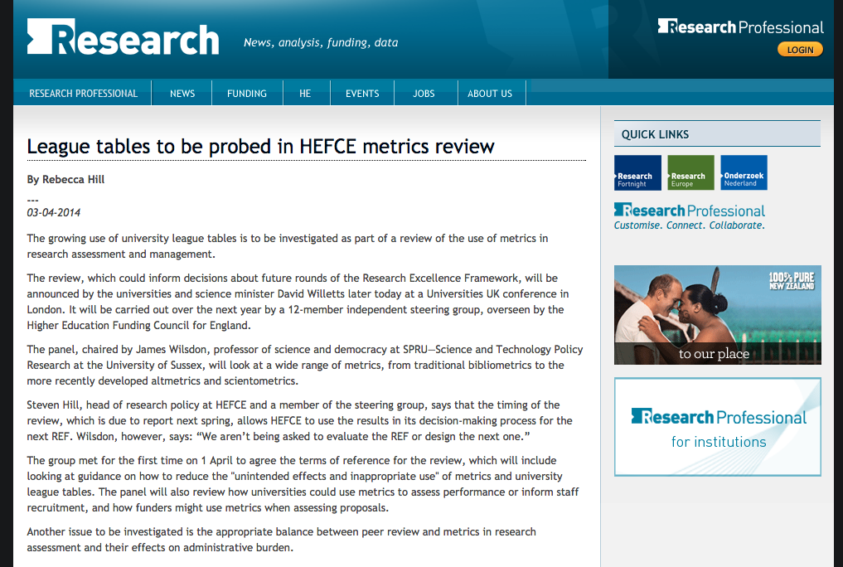

Slide 4
Independent Review of Metrics – Terms of Reference (1)
The review will consider the role that metrics-based assessment could play in determining quality, impact and other key characteristics of research undertaken in the higher education sector. Issues to be investigated include:
The relative merits of different metrics in assessing the academic qualities and diverse impacts of research.
The advantages and disadvantages of using metrics, compared with peer review, in creating an environment that enables & encourages excellent research & impact, including fostering inter-/ multi-disciplinary research.
Consideration of how metric-based research assessment fits within the missions of universities and research institutes and the value that they place on research outputs in relation to the portfolio of other activities undertaken by their staff, including training and education.
The potential contribution of metrics to other aspects of research assessment, such as the matching of reviewers to proposals.

Slide 5
Independent Review of Metrics – Terms of Reference (2)
The appropriate balance between peer review and metrics in research assessment, and the consequences for administrative burden and research cultures across different disciplines.
What is not, or cannot, be measured by quantitative metrics.
The differential impacts of metrics-based assessment on individual researchers, including consideration of the implications for early-career researchers, equality and diversity.
Ethical considerations and guidance on how to reduce the unintended effects and inappropriate use of metrics and university league-tables, including the impact of metrics-based assessment on research culture.
The extent to which metrics could be used by HEIs in their internal processes and by research funders in the assessment of research.

Slide 6
Independent Review of Metrics – Steering Group
The review will be chaired by James Wilsdon, Professor of Science and Democracy at the Science Policy Research Unit (SPRU), University of Sussex. He will be supported by an independent steering group and a secretariat from HEFCE’s Research Policy Team:
Dr Liz Allen (Head of Evaluation, Wellcome Trust)
Dr Eleonora Belfiore (Associate Professor of Cultural Policy, University of Warwick)
Dr Philip Campbell (Editor-in-Chief, Nature)
Professor Stephen Curry (Department of Life Sciences, Imperial College London)
Dr Steven Hill (Head of Research Policy, HEFCE)
Professor Richard Jones FRS (Pro-Vice-Chancellor for Research and Innovation, University of Sheffield) – representative of the Royal Society
Professor Roger Kain FBA (Dean and Chief Executive, School of Advanced Study, University of London) – representative of the British Academy
Dr Simon Kerridge (Director of Research Services, University of Kent) – representative of the Association of Research Managers and Administrators
Professor Mike Thelwall (Statistical Cybermetrics Research Group, University of Wolverhampton)
Jane Tinkler (London School of Economics and Political Science)
Dr Ian Viney (Head of Evaluation, Medical Research Council)
Professor Paul Wouters (Centre for Science and Technology Studies, University of Leiden)

Slide 7
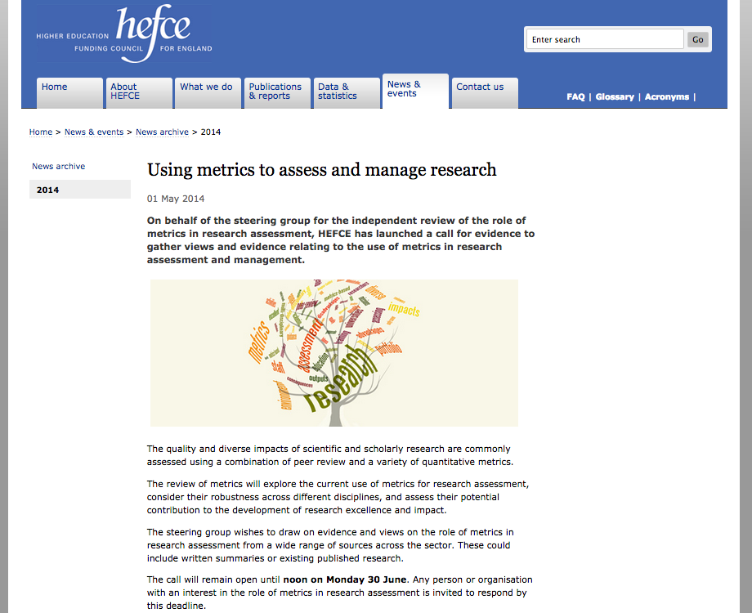

Slide 8
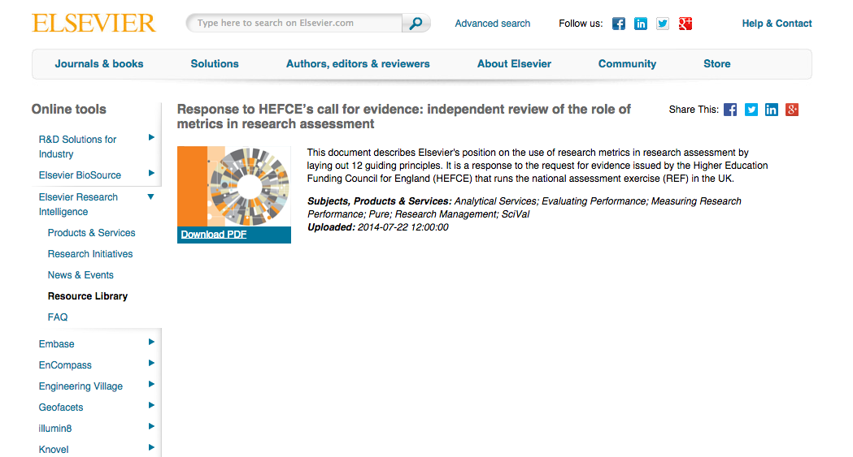

Slide 9
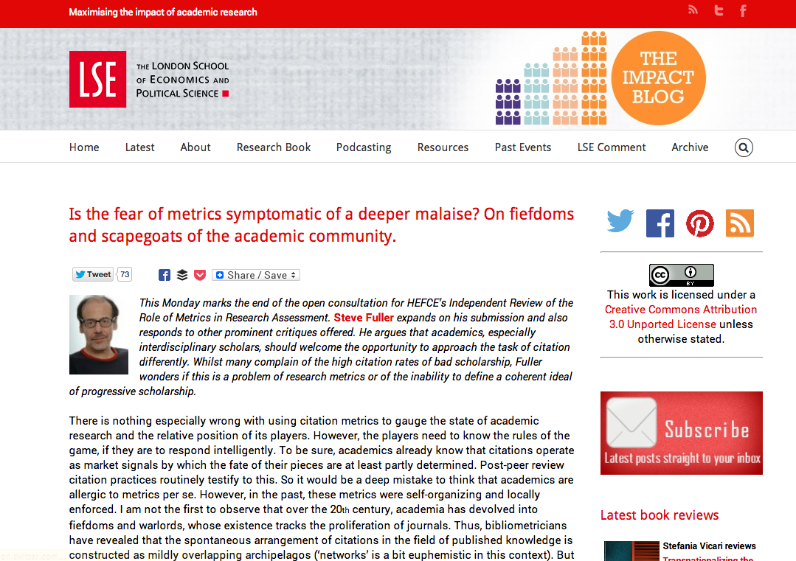

Slide 10
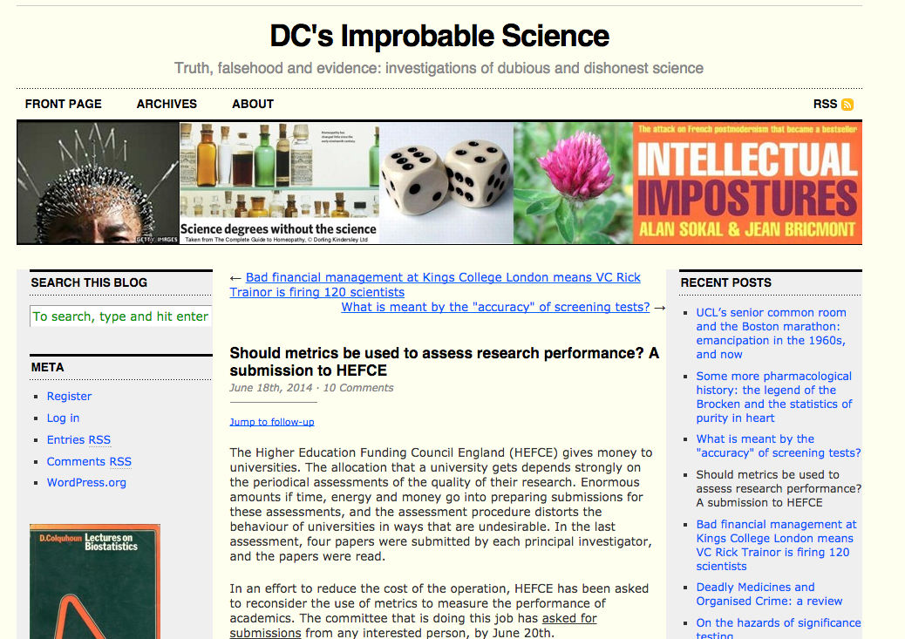

Slide 11
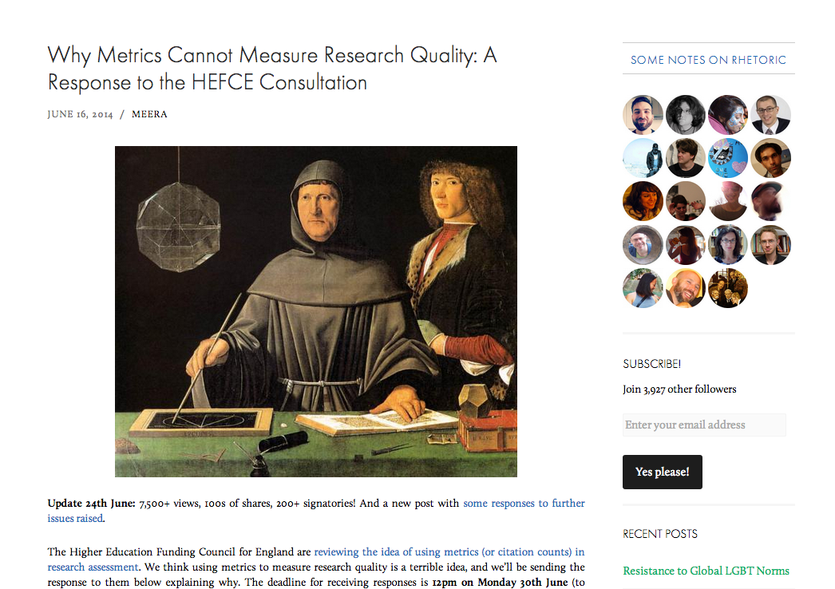

Slide 12
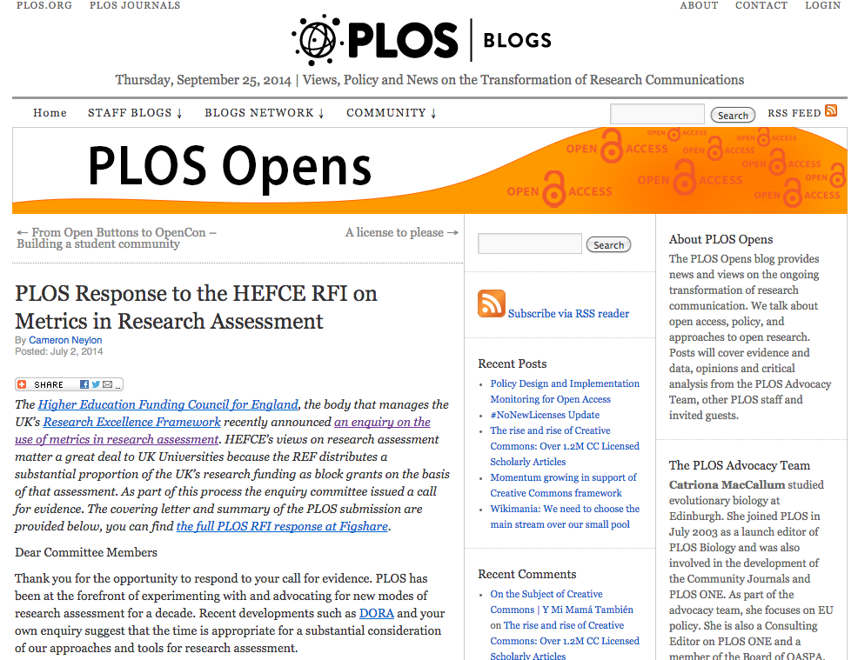

Slide 13
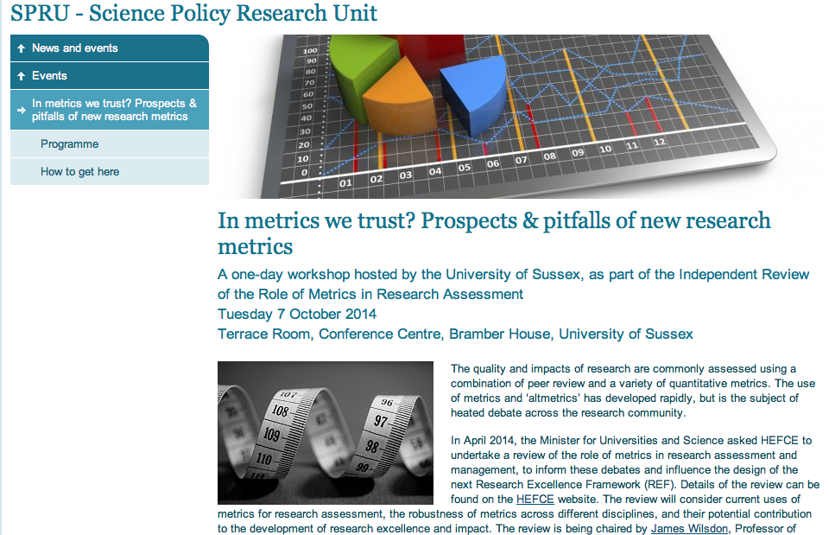

Slide 14
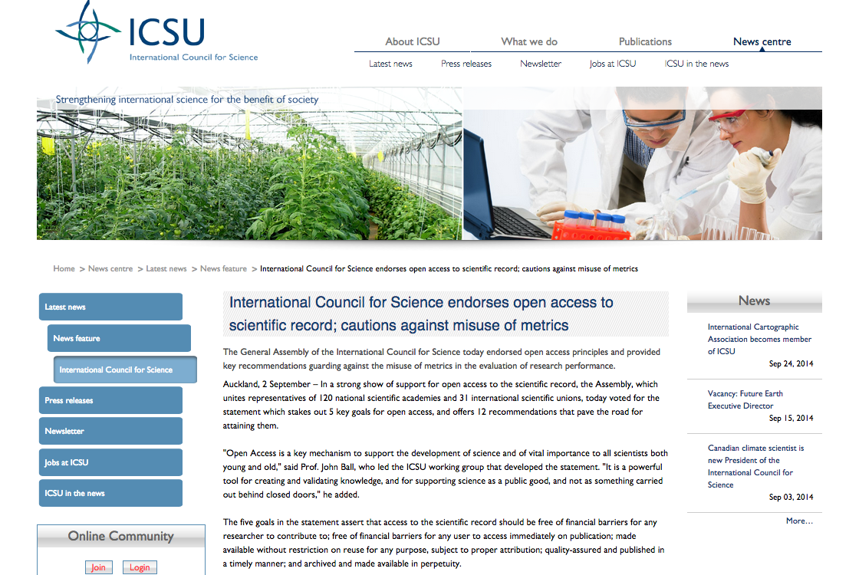

Slide 15
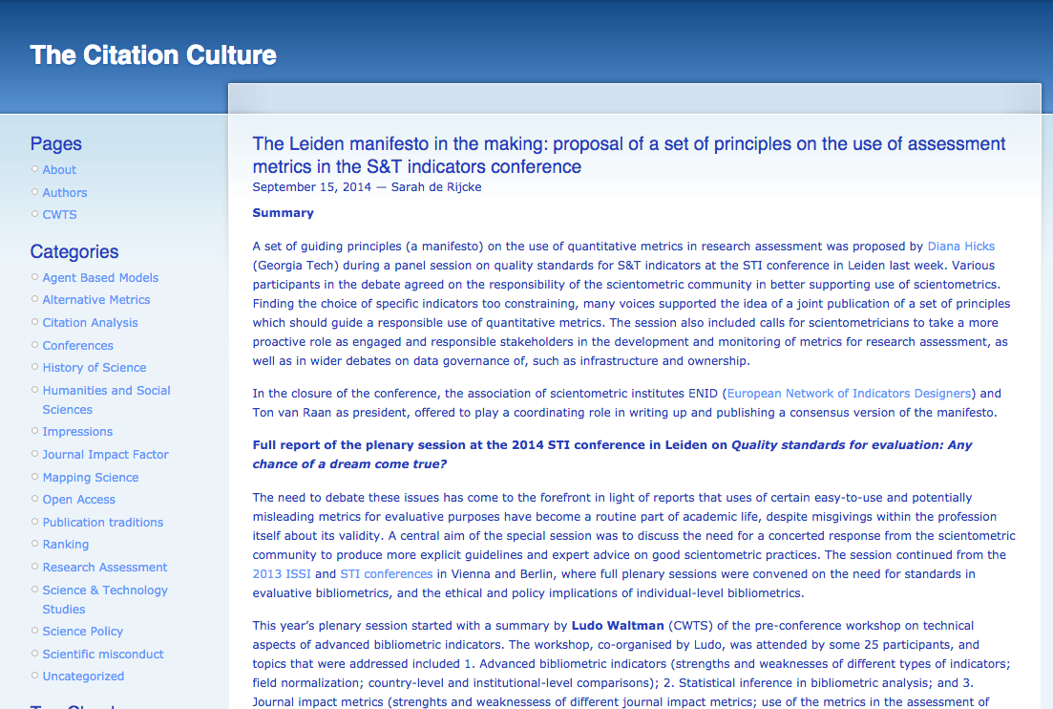

Slide 16
Independent Review of Metrics – timetable
7 Oct 14 - In metrics we trust? Workshop at Uni of Sussex
28 Nov 14 - Focus groups with REF panel members
2 Dec 14 - Metrics, equality & diversity workshop at Uni of Sheffield
18 Dec 14 – REF 2014 results published
Jan/Feb15 – REF evaluations complete; drafting of metrics review report
25 March 15 – HEFCE future of research assessment event; provisional review findings announced (ahead of election purdah period)
June15 – Metrics review final report published (with recommendations against 3 time horizons?)

Slide 17

James Wilsdon, @SPRU @jameswilsdon

